Slide 1
Alan Liu, U. California, Santa Barbara Twitter: @alanyliu
Map of the Digital Humanities v. 2.1 (8 Sept. 2015)
A map is not a definition. It is a way of moving around and showing others how to get from somewhere they know to somewhere unknown within a reasonable compass.
There has been much internal debate in the digital humanities (DH) community (or communities) about the field’s definition or whether it should have one.
For scholars outside the field and the general public (as spoken for by journalists and pundits), definitions are often wanted for quick grasp, accurate or not.
For both DH insiders and outsiders , I offer this map. It’s good enough for the time being. (And if not, tell me and I will evolve it.) A map is not a definition. It is a way of moving around and showing how to get around. Maps change as the ground changes. This map will change.

Slide 2
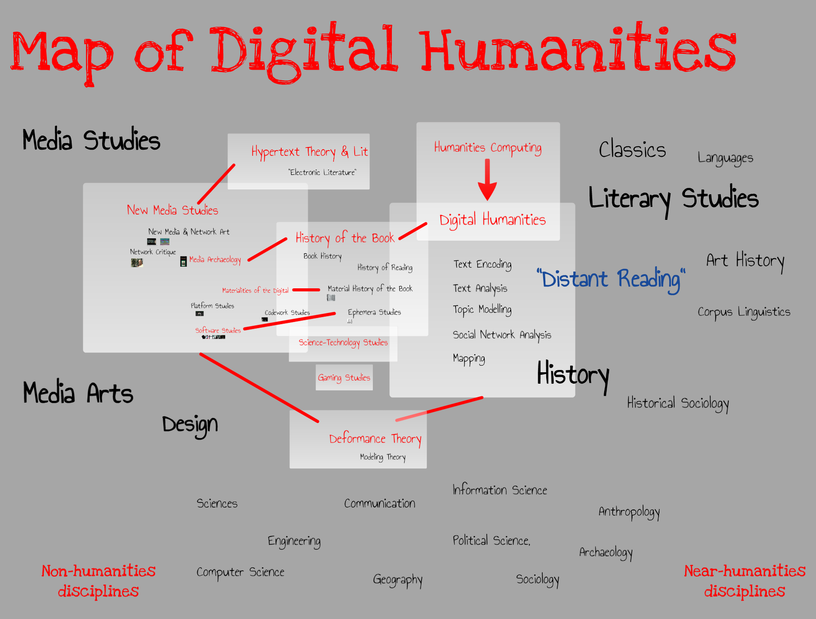
Alan Liu, U. California, Santa Barbara Twitter: @alanyliu
Map of the Digital Humanities v. 2.1 (8 Sept. 2015)
Here’s a panoramic view of the overall terrain that could reasonably be called “digital humanities” in some context—institutional, research, or pedagogical. Let’s call this the genus concept of the digital humanities.

Slide 3
Alan Liu, U. California, Santa Barbara Twitter: @alanyliu
Map of the Digital Humanities v. 2.1 (8 Sept. 2015)
In the last ten years or so, the specific phrase “digital humanities” has come to stand for one quadrant of the map in particular (blue rectangle). This is the species concept of DH.
DH in this sense evolved from an earlier genealogy of “humanities computing.”
It affiliates with the older, core humanities disciplines of history, literature, classics, etc.
Often, though not exclusively, it focuses on encoding and analyzing text.
It is often considered a mode of reading—e.g., a theory and practice of “distant reading.”

Slide 4
Alan Liu, U. California, Santa Barbara Twitter: @alanyliu
Map of the Digital Humanities v. 2.1 (8 Sept. 2015)
DH in the species sense now has its own history, bibliography, programs, journals, and critics.
► Susan Hockey, "The History of Humanities Computing" (2004)
► John Unsworth, "What’s 'Digital Humanities' and How Did It Get Here?" (2012)
► Meredith Hindley, "The Rise of the Machines--NEH and the Digital Humanities: The Early Years" (2013)
► Matthew G. Kirschenbaum, "What is Digital Humanities and What's It Doing in English Departments?" [PDF] (2010)
► Programs in Digital Humanities
► Digital Humanities Quarterly
► Debates in the Digital Humanities
► “Dark Side of the Digital Humanities”
► Etc.

Slide 5
Alan Liu, U. California, Santa Barbara Twitter: @alanyliu
Map of the Digital Humanities v. 2.1 (8 Sept. 2015)
The neighboring species is often called “new media studies” (green rectangle).
Its genealogy stems from media studies, digital arts, and design, which are new (and newer) entrants in the humanities.
Partly because of the avant-garde and tradition-breaking traditions of those fields, new media studies has often had a stronger emphasis on cultural critique.
New media studies also has a stronger focus on contemporary media, including networked, social-networked, and visual media.

Slide 6
Alan Liu, U. California, Santa Barbara Twitter: @alanyliu
Map of the Digital Humanities v. 2.1 (8 Sept. 2015)
Individual scholars can span across “digital humanities” and “new media studies,” and there is other overlap. (The “species” metaphor breaks at this point.)
But at present there is little formalized communication between DH and new media studies in the way of programs, centers, or even conferences.
Someone needs to make a major conference that puts DH and new media studies (including also “network critique”) people in the same room together.

Slide 7
Alan Liu, U. California, Santa Barbara Twitter: @alanyliu
Map of the Digital Humanities v. 2.1 (8 Sept. 2015)
In the meantime, there are intriguing “missing link” fields on the map that are de facto land bridges between the continents of DH and new media studies.
One conspicuous example is history of the book (purple rectangle). Book history after McLuhan is really a branch of media studies—as witnessed in such approaches as “material history of the book” or “ephemera” studies. It is a “media archaeology” that spans between DH and new media studies.
“Deformance” theory in DH, or “glitch” theory as it is known in new media studies, crosses between too.

Slide 8
Alan Liu, U. California, Santa Barbara Twitter: @alanyliu
Map of the Digital Humanities v. 2.1 (8 Sept. 2015)
Finally, there is the broad delta of non-humanities disciplines that the digital humanities draw upon, collaborate with, or find “near humanities” allies among (yellow rectangle).
These include not just the fields of computer science and information science but the digital vanguard in communication, sociology, political science, anthropology, archaeology, geography, and so on.

Slide 9
Alan Liu, U. California, Santa Barbara Twitter: @alanyliu
Map of the Digital Humanities v. 2.1 (8 Sept. 2015)
To change metaphors: “It takes a village” (the narrower sense of digital humanities)...
But it also takes a city and a world (the big map of the digital humanities).

Slide 10
Alan Liu, U. California, Santa Barbara Twitter: @alanyliu
Map of the Digital Humanities v. 2.1 (8 Sept. 2015)
This is not the last word, or the last map.
It will all change.
--Alan Goleta, California; 8 September 2015

